Slide 1
ML on OpenMV Cam H7(+) with STM32 Cube AI

Slide 2
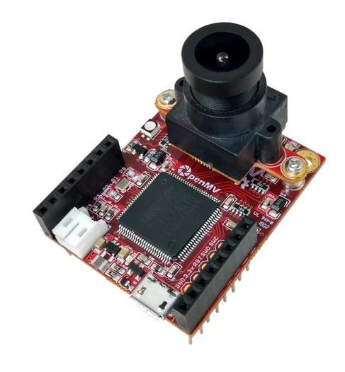
Introduction
This project shows how to develop and deploy NNs on a resource constrained environment such as OpenMV Cam by using stm32cubeai.
OpenMV Cam H7(+) enables fast prototyping of vision-based applications. It is based on STM32 H7 ARM Cortex processor and it is programmable with Python thanks to the MicroPython OS. It features a fully accessibility to its I/O pins (e.g. GPIO, UART, SPI, I²C).
Reference
Needed softwares operating on Ubuntu x64 OS up-to-date and Python3 (to upgrade your environment, run on terminal:
sudo apt update
sudo apt upgrade
sudo apt install git zip make build-essential tree
Java Runtime Environment (JRE): it makes possible the installation of the following components
STM32CubeMX: it permits to generate source code
STM32CubeAI Expansion pack: it enables analysis, compression and code generation for NNs
OpenMV IDE: it permits to flash firmware, write and execute python scripts
GNU ARM Toolchain: it permits to compile the firmware

Slide 3
Installations
JRE: run on command line: sudo apt install openjdk-11-jre
Verify installation with: java –version
The output should be: openjdk version "11.0.9.1" 2020-11-04
STM32CubeMX: it requires JRE. It is a software provided by ST. For this project purpose, it is useful to analyse NNs and generate source code thanks to its AI expansion pack.
Installation: get .zip from here, open the folder and follow the instructions on the Readme.html file.
STM32CubeAI Expansion pack: there are two versions: GUI and command line.
GUI: It is possible to use it to evaluate and analyse NNs in an easy and fast way.
Open CubeMX, click on “Install or Remove embedded software packages”.
From the “STMicroelectronics” tab select X-CUBE-AI and install the 5.2.0 version.

Slide 4
Installations (Cont’d)
stm32ai Command Line: for a better directory organization create a new folder with the command:
mkdir $HOME/openmv_workspace
Download the latest version of X-CUBE-AI from here in the created folder
Pay attention to download the 5.2.0 version, otherwise some problems may arise.
` Then, run the following commands:
cd $HOME/openmv_workspace
chmod 644 en.x-cube-ai-v5-2-0.zip
unzip en.x-cube-ai-v5-2-0.zip
mv STMicroelectronics.X-CUBE-AI.5.2.0.pack STMicroelectronics.X-CUBE-AI.5.2.0.zip
unzip STMicroelectronics.X-CUBE-AI.5.2.0.zip -d X-CUBE-AI.5.2.0
mkdir X-CUBE-AI.5.2.0/Utilities
mv stm32ai-linux-5.2.0.zip X-CUBE-AI.5.2.0/Utilities/.
cd X-CUBE-AI.5.2.0/Utilities/
unzip stm32ai-linux-5.2.0.zip

Slide 5
Installations (Cont’d)
Then, add permanently stm32ai in your “~/.bashrc”:
nano ~/.bashrc
at the end of the file add:
export PATH=~/openmv_workspace/X-CUBE-AI.5.2.0/Utilities/linux:$PATH
exit and save.
Finally check the installation by running:
stm32ai –version
The output should look like: “stm32ai - Neural Network Tools for STM32 v1.4.0 (AI tools v5.2.0)”

Slide 6
Installations (Cont’d)
OpenMV IDE: Download it form here. Double click on the file and follow the instructions.
AI libraries: pip3 install keras tensorflow
pip3 install launchpadlib testresources
GNU ARM Toolchain:
Go at this link and download the Linux x86_64 Tarball version. You can check its integrity by running the command: md5sum gcc-arm-none-eabi-10.3-2021.07-x86_64-linux.tar.bz2 to avoid future problems.
Unpack the archive inside a common directory such as usr/share with: sudo tar xjf gcc-arm-none-eabi-your-version.bz2 -C /usr/share/
At this point, create all the symbolic links needed to the stm32ai program. To do so, execute the sequence of commands of the following slide, one by one.
NOTE: the password would be requested only for the first sudo command.

Slide 7
Installations (Cont’d)
sudo ln -s /usr/share/gcc-arm-none-eabi-your-version/bin/arm-none-eabi-gcc /usr/bin/arm-none-eabi-gcc
sudo ln -s /usr/share/gcc-arm-none-eabi-your-version/bin/arm-none-eabi-g++ /usr/bin/arm-none-eabi-g++
sudo ln -s /usr/share/gcc-arm-none-eabi-your-version/bin/arm-none-eabi-gdb /usr/bin/arm-none-eabi-gdb
sudo ln -s /usr/share/gcc-arm-none-eabi-your-version/bin/arm-none-eabi-size /usr/bin/arm-none-eabi-size
sudo ln -s /usr/share/gcc-arm-none-eabi-10.3-2021.07/bin/arm-none-eabi-as /usr/bin/arm-none-eabi-as
sudo ln -s /usr/share/gcc-arm-none-eabi-10.3-2021.07/bin/arm-none-eabi-cpp /usr/bin/arm-none-eabi-cpp
sudo ln -s /usr/share/gcc-arm-none-eabi-10.3-2021.07/bin/arm-none-eabi-ld /usr/bin/arm-none-eabi-ld
sudo ln -s /usr/share/gcc-arm-none-eabi-10.3-2021.07/bin/arm-none-eabi-ar /usr/bin/arm-none-eabi-ar
sudo ln -s /usr/share/gcc-arm-none-eabi-10.3-2021.07/bin/arm-none-eabi-strip /usr/bin/arm-none-eabi-strip
sudo ln -s /usr/share/gcc-arm-none-eabi-10.3-2021.07/bin/arm-none-eabi-objdump /usr/bin/arm-none-eabi-objdump
sudo ln -s /usr/share/gcc-arm-none-eabi-10.3-2021.07/bin/arm-none-eabi-objcopy /usr/bin/arm-none-eabi-objcopy
If something does not work as expected, try to change the modifier –s into –sf (which forces the symlink creation).
Check the toolchain installation with:
arm-none-eabi-gcc –version
The output should look like: “arm-none-eabi-gcc (GNU Tools for Arm Embedded Processors 7-2018-q3-update) 7.3.1 20180622 (release) [ARM/embedded-7-branch revision 261907]”
You can also check all the others executables.

Slide 8
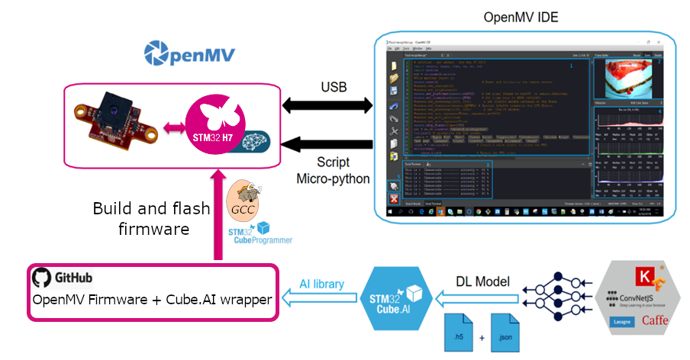
Toolchain Overview
Train your neural network by using your favorite deep learning framework.
Convert your trained network to optimized C code using STM32Cube.AI tool
Download the OpenMV firmware source code, and
Add the generated files to the firmware source code
Compile with GCC toolchain
Flash the board using OpenMV IDE
Program the board with microPython and perform inference

Slide 9
NN Training
The NN training is carried out by using tensorflow with Keras backend. The MNIST dataset has been used because it is easily accessible from Keras and it involves a simple CNN architecture. Nevertheless, this example can be scaled on different types of applications. The NN training is referred to the “Mnist.ipynb” jupyter notebook file which can be opened with Google Colaboratory. The script consists in:
Load the MNIST dataset split into train and test
Pre-process the dataset
Define a NN architecture as follows:
Input(28, 28)→Conv2D→MaxPooling→Flatten→Softmax Output
Train the NN and make predictions to test its accuracy post training
Save the NN .h5 file
Quantize the floating point model with int8 precision:
- Full integer quantization: also the input and output are quantized
- Integer with float fallback: input and output use float precision as default
The quantized models are saved as .tflite files
From Google Colab it is possible to download the saved files in your computer.

Slide 10
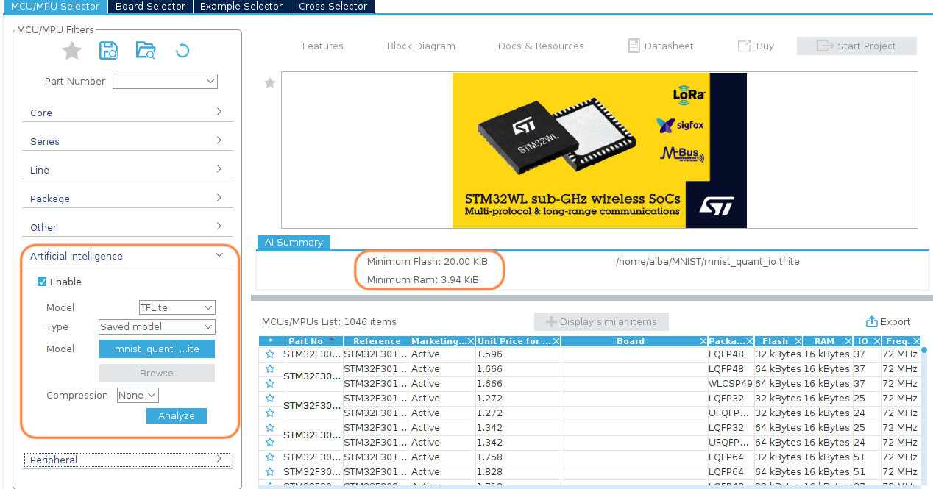
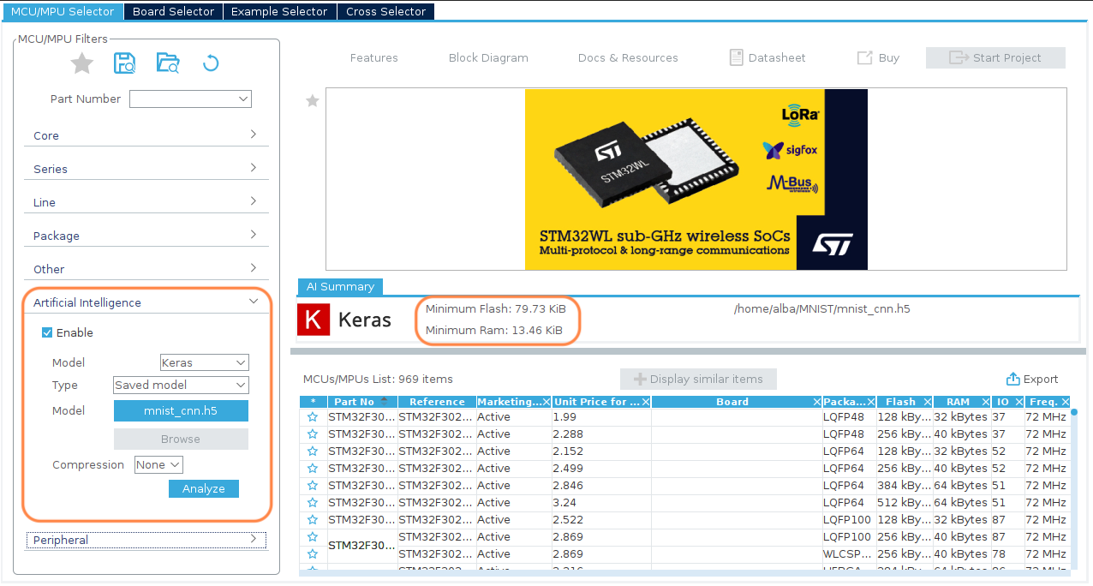
Analyse NN (optional)
First of all, it is possible to analyse a NN model (e.g. .h5, .tflite) with CubeMX:
Open it and click on “install or remove embedded software packages”, in “STMicroelectronics” tab choose X-CUBE-AI and install the latest version
Open a new project and tick on “Enable” on the Artificial Intelligence tab
Here, it is possible to simply analyse a NN model by browsing it. The program return the minimum flash and RAM size

Slide 11
Download and prepare OpenMV project
It is necessary to add the OpenMV source code by cloning its git repository:
cd openmv_workspace
git clone --recursive https://github.com/openmv/openmv.git
cd openmv/src/micropyhton/mpy-cross
make
Add the STM32Cube.AI library to OpenMV
cd $HOME/openmv_workspace/openmv/src/stm32cubeai
mkdir -p AI/{Inc,Lib}
mkdir data
cp $HOME/openmv_workspace/X-CUBE-AI.5.2.0/Middlewares/ST/AI/Inc/* ./AI/Inc/
cp $HOME/openmv_workspace/X-CUBE-AI.5.2.0/Middlewares/ST/AI/Lib/GCC/STM32H7/NetworkRuntime520_CM7_GCC.a ./AI/Lib/NetworkRuntime_CM7_GCC.a
nano "~/openmv_workspace/openmv/src/Makefile”
Edit line 30 by changing the line: "PYTHON = $(Q)python" to: "PYTHON = $(Q)python3"

Slide 12
Generate the code for a NN model (in VM)
After having trained a NN model, it is possible to generate an optimized C code for this network thanks to STM32Cube.AI. Then, this files will be added to OpenMV firmware source code. For this purpose, the stm32ai command line tool has to be used:
cd ~/openmv_workspace/openmv/src/stm32cubeai
stm32ai generate -m "<model>" -o data/
To try out if the installation was successful, use the trained example:
cd $HOME/openmv_workspace/openmv/src/stm32cubeai
stm32ai generate -m example/mnist_cnn.h5 -o data/
Then, the following files are generated in ~/openmv_workspace/openmv/src/stm32cubeai/data:
network.h
network.c
network_data.h
network_data.c
network_generate_report.txt makes available a detailed report about the converted NN
They refer to the network topology
They refer to the network weights

Slide 13
Pre-processing (in VM)
The OpenMV camera sensor acquires images in the format RGB565 (i.e. 2 bytes), but, to perform inferences, it is necessary to convert it to the format RGB888 (i.e. 3 bytes) since the network has been trained on this image types. However, if the network uses grey scale images (i.e. single channel and 1 byte), no pre-processing is needed.
By default, the script performs the following:
Image resizing (subsampling)
Conversion from unsigned char to float
Scaling pixels from 255 to 1
NOTE:
If you need some special pre-processing, you should modify the function “ai_transform_input” located into “src/stm32cubeai/nn_st.c”.
If you are using quantized models refer to the last slide.

Slide 14
Build OpenMV firmware (in VM)
Before building the OpenMV firmware, few modifications in the config files are needed:
nano "~/openmv_workspace/openmv/src/omv/boards/{your OpenMV cam}/omv_boardconfig.h”
Edit line 148 by setting: “OMV_HEAP_SIZE” to 230K
cd ~/openmv_workspace/openmv/src
make clean
make TARGET=OPENMV4 CUBEAI=1
NOTE: if the board is a H7+, the make command must be:
make TARGET=OPENMV4P CUBEAI=1
Finally, if the building successes the output should look like in the image and in “~/openmv_workspace/openmv/src/build/bin/” you can find the generated firmware.
Troubleshooting:
It may be possible that warnings are treat as errors, therefore few errors occur. To solve that:
nano “~/openmv_workspace/openmv/src/omv/ports/stm32/omv_portconfig.mk” and remove in line 7 (CFLAGS): –werror and –warray-bounds
It can be possible that the compilation fails because of an error about the heap size:
Edit the file “omv_boardconfig.h” as before and lower the OMV_HEAP_SIZE by few kB and try again.
IMPORTANT: Run “make clean” between builds.

Slide 15

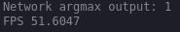
Flash the firmware (native installation)
If you installed the Toolchain in your system, follow this guide.
To flash the generated firmware into the OpenMV:
Open OpenMV IDE
Go to Tools → Run Bootloader → and browse “firmware.bin”
Then, it is possible to write a Pyhton program with OpenMV IDE that runs on the camera. For simplicity, few examples ready to use are available. For this purpose go to:
File → Examples → OpenMV → Machine-Learning → nn_stm32cubeai.py
In this example the nn_st library is used to perform predictions with a model generated with the stm32ai command line tool. However, more examples which uses Tensorflow library are available as well where it is possible to use .tflite models.

Slide 16
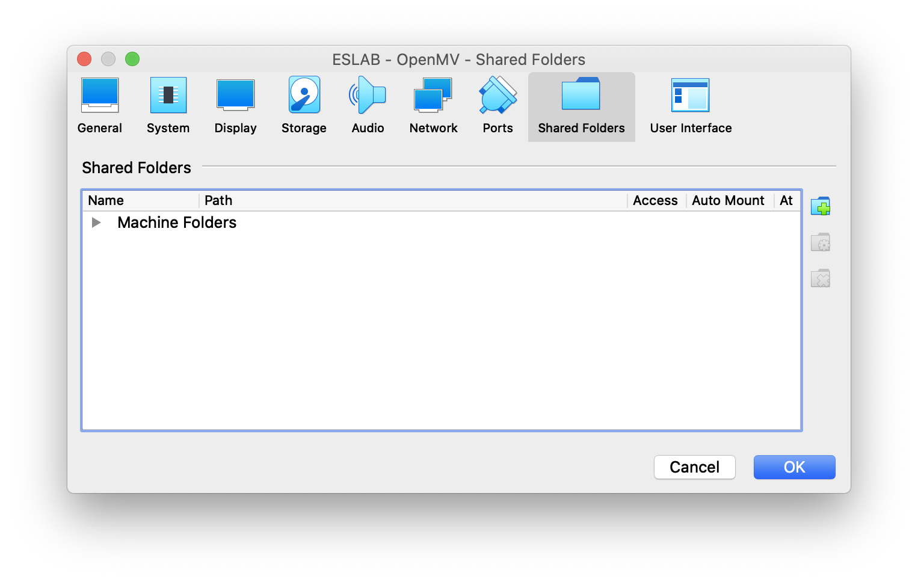
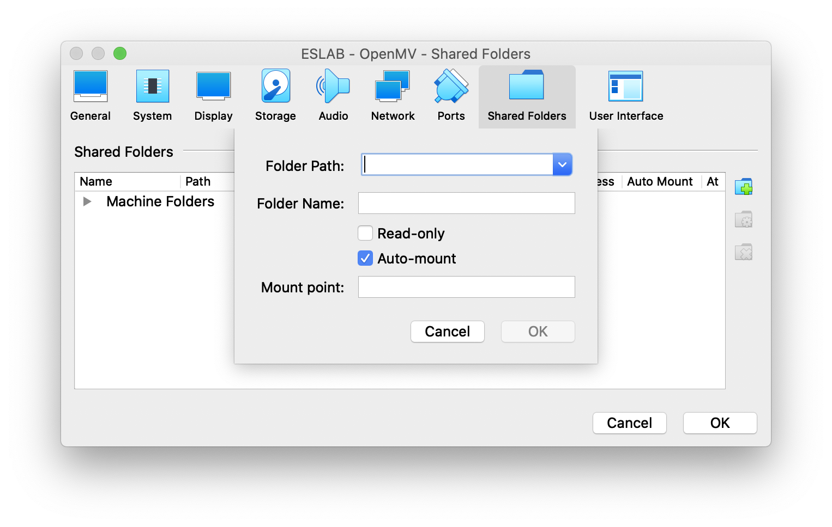
Flash the firmware (virtual machine installation)
If the toolchain was installed in a virtual machine, a few more steps are required, basically for ease of use.
In your VirtualBox app, click on Devices and on Insert Guest Additions CD image. Simply follow the instructions and restart your VM.
At this point, shut the VM down and on VirtualBox go in Settings and in the Shared Folders tab. Click on the highlighted button. Select a folder on your Host system in Folder Path, choose a name in Folder Name, check the Auto-mount option and click OK.

Slide 17
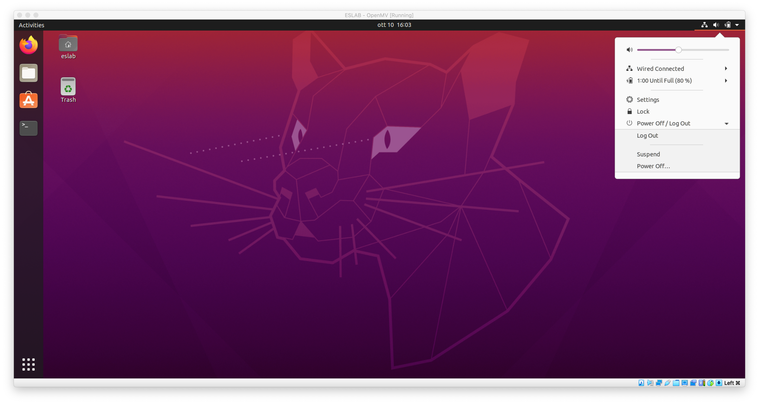
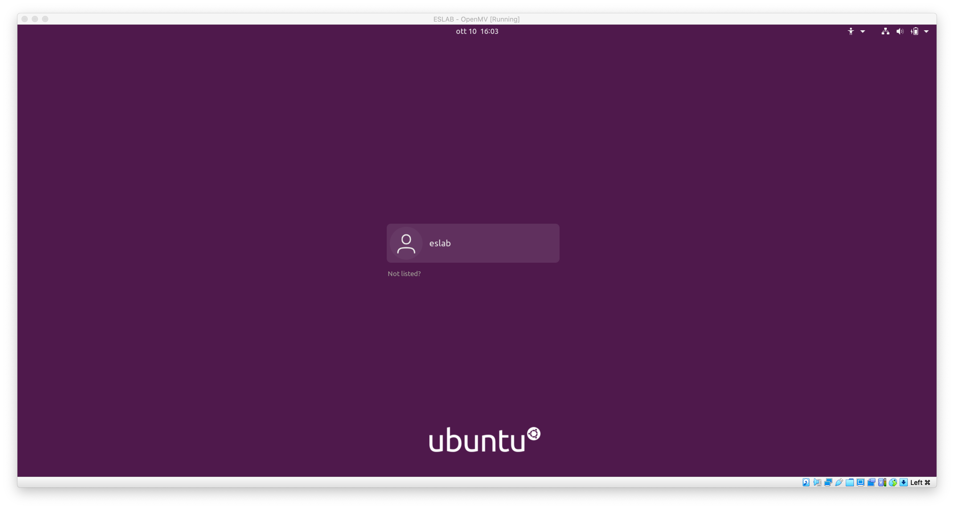
Flash the firmware (virtual machine installation)
Start the Linux VM (or reboot it).
Open a terminal window and type the command:
sudo usermod -a -G vboxsf `whoami`
and type the password.
NOTE: whoami is a Linux placeholder that automatically shows the name of the user, without searching for it on the system.
Then:
sudo chown -R `whoami`:users /media/
Now, log out and back in as shown in the pictures.
You are now able to write from and to the folder, which is shared with your Host system. This is needed to flash the firmware using the bootloader, since the handshaking procedure does not work well inside a VM (unless you decide to passthrough the controller, which is much more complex).

Slide 18
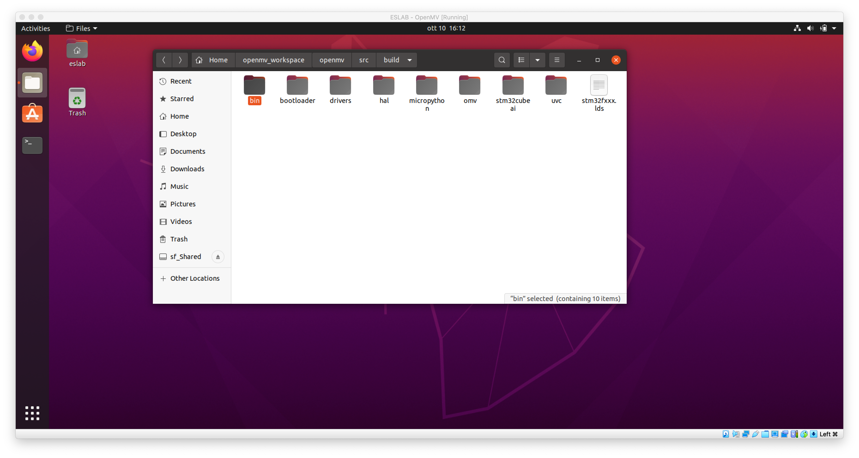
Flash the firmware (virtual machine installation)
At this point, locate the /bin folder that contains the newly generated firmaware and copy it inside the shared folder. It should be present on the side bar of the file explorer.
The copied files are now available to the Host OS. The steps are exactly the same, only on your native OS.
To flash the generated firmware into the OpenMV:
Open OpenMV IDE on your host system.
Go to Tools → Run Bootloader → and browse “firmware.bin”; it will be located in the folder selected on the VM Settings
Then, it is possible to write a Pyhton program with OpenMV IDE that runs on the camera. For simplicity, few examples ready to use are available. For this purpose go to:
File → Examples → OpenMV → Machine-Learning → nn_stm32cubeai.py
In this example the nn_st library is used to perform predictions with a model generated with the stm32ai command line tool. However, more examples which uses Tensorflow library are available as well where it is possible to use .tflite models.
Path to the /bin folder on the Linux VM
Folder to be copied in the shared one
Shared folder, should be present on your native OS at the path chosen.

Slide 19
Quantized models
If you are using quantized models, few modifications about the pre-processing and prediction function are needed in order to modify the float variables into int variables:
Go to “openmv/src/stm32cubeai/nn_st.c”
In the function “ai_transform_input” uncomment the code part which refers to quantized models and comment the one that refers to float pointers
Go to “openmv/src/stm32cubeai/py_st_nn.c”
In the function “py_net_predict” replace on line 51 “float” with “ai_u8”, and, in line 54, replace “mp_obj_new_float” with “mp_obj_new_int”.
Moreover, an additional modification is needed into the configuration file “openmv/src/stm32cubeai/cube.mk”:
In the last line “LIBS” add: -lgcc -L/usr/lib/gcc/arm-none-eabi/7.3.1/thumb/v7e-m/fpv4-sp/hard/
In general, verify that the "libgcc.a" library is on the path you are linking
Then, it is possible to generate the code for a quantized model and build the firmware as explained before.

